Slide 1
Inventory
Management System
Miss. Jadhav Shivani Santosh Div. A Roll No. 20148

Slide 2
INTRODUCTION
The project titled "Inventory management System" is Inventory management software for monitoring and controlling the transactions in a Firm .The project “Inventory management System" is developed in python, which mainly focuses on basic operations in a Firm like Managing employee information, supplier information, Product and Managing sales .
“Inventory management System" is a desktop application, designed to help users maintain and organize Inventory of firm. Our software is easy to use for both beginners and advanced users. It features a familiar and well thought-out, an attractive user interface, combined with strong Insertion and Updating capabilities.
The software Inventory management System" has four main modules. Insertion to Database Module – User friendly input screen, Extracting from Database module – Attractive Output Screen

Slide 3
Existing System
The existing system is manual due to which there area complications while switching to different documents as well as generating reports. The existing system consists of following;
At the record are to be manually maintain it consumes lot of time.
Lot of paper work is involved as the record is maintained in the files and register.
As file and register are used the space requirement is increased.
Use of paper for storing valuable data information is not all reliable.
It is very difficult to update or maintain all records.
The existing system forces us to do all the tasks manually via paperwork which is outdated.

Slide 4
PROPOSED SYSTEM
Proposed system is an automated Inventory management System. Through our software Firm Owner can keep record of employee, view their information , easy to search for sales and keep track of products, update information, edit information in quick time. Our proposed system has the following advantages.
Ø User friendly interface
Ø Fast access to database
Ø Less error
Ø Look and Feel Environment
Ø Quick transaction
All the manual difficulties in managing the Firm have been rectified by implementing computerization.

Slide 5
Scope of the System:-
It manages all the information about Employees, Sales , Products. The purpose of the project is to build an application program to reduce the manual work for managing the Firm. It tracks all the details about the Employees, Sales, Products and suppliers.
Functionalities provided by Inventory management System are as follows:
Inventory management System Provides the different types of department and co-ordinates them to take right decisions and reduces manual work with their all information.
Manage the information of Department.

Slide 6
Hardware And Software Requirement: -
Hardware :
• Processor : Intel(R) Core(TM) i3-8130U
• RAM : 4GB or More
• Hard Disk : 500GB
• Printer : Laser / Inkjet
Software Requirement:
• Front-End : python
• Back-End : SQLite
• Operating System : Windows 10

Slide 7
ERD
eid
pass
Customer
gives
order
to
Login
cid
gives
name
pid
gives
category
Category/stock
supplier
price
utype
eid
pays
Product
salary
name
address
gmail
name
Admin
qty
status
gender
manage
pass
doj
contact
dob
Supplier
invoice
Bill
generate
desc
name
contact

Slide 8
Use case
Login
Manage Employee
Manage Supplier
Manage Category
Gives Order
Manage Product
Customer
Admin
Bill
Manage Sales
Logout

Slide 9
Activity
Diagram
Login
Receive order
Manage system
Employee
supplier
product
category
sales
Billing
reporting
has
Sales invoice
Gives order
Logout

Slide 10
DFD
Customer
Supply products
Supplier
Gives Order
Pay Bill
Supplier invoice bill
Gives product order
0.0
Inventory system
Supplier payment
Order deliver
Bill receipt
Sales & invoice billing
Order product
Order receive
Manage all reports
Employee
Updated product stock
Admin
Manage product stock
Order deliver

Slide 11
Inventory management
system
Employee login
Admin Login
Change login password
Admin
New employee
Employee
Administrative
Administrative details
Category/ product in stock
Sales bill and payment details

Slide 12
Customer
order
Order details
Employee
payment
Payment
Payment receipt
Inventory
Management system
Hotel
Management system
Receipt
Order deliver
Bill
Salles bill details
Order deliver
Sales bill details
Payment collection
Menu items
Admin
Menu item rates

Slide 13
Class
Diagram
Admin class
Customer class
Category class
Eid
Name
Gmail
Gender
Contact
Dob
Doj
Pass
Utype
Address
cid
name
name
contact
1
Gives order ()
Bill receipt ()
Add ()
Update ()
Delete ()
Employee report ()
Product report ()
Supplier report ()
Category report ()
Sales report ()
*
*
Employee class
Supplier class
*
Eid
Name
Gmail
Gender
Contact
Dob
Doj
Pass
Utype
Address
salary
Product class
Invoice
Name contact desc
Pid
category
supplier
Name
Qty
Price
status
*
Add ()
Update ()
Delete ()
Add ()
Update ()
Delete ()
Add ()
Update ()
Delete ()

Slide 14
Object
Digram
Admin class
C: Customer
Eid
Name
Gmail
Gender
Contact
Dob
Doj
Pass
Utype
Address
1
M: Category
name
contact
cid
name
*
*
S: Supplier
*
E: Employee
P: Product
Invoice
Name contact desc
Eid
Name
Gmail
Gender
Contact
Dob
Doj
Pass
Utype
Address
salary
Pid
category
supplier
Name
Qty
Price
status
*

Slide 15
Employee
Fields | Data Type | Size | Constraints | Description
Eid | Int | 5 | Primary key | Employee id
name | Varchar | 50 | Not null | Employee name
Gmail | Varchar | 50 | Not null | Gmail
Gender | Varchar | 20 | Not null | Gender
Contact | Int | 10 | Not null | Phone no
Dod | Varchar | 10 | Not null | Date of birth
Doj | Varchar | 10 | Not null | Date of join
Pass | Int | 8 | Not null | Password
Utype | Varchar | 20 | Not null | User type
Address | Varchar | 100 | Not null | Address
Salary | int | 5 | Not null | Salary

Slide 16
Category
Fields | Data Type | Size | Constraints | Description
cid | Int | 5 | Primary key | Category id
name | Varchar | 50 | Not null | category name
Supplier
Fields | Data Type | Size | Constraints | Description
Invoice | Int | 5 | Primary key | Invoice number
Name | Varchar | 50 | Not null | Supplier name
contact | Varchar | 10 | Not null | Contact
Desc | Varchar | 50 | Not null | Description

Slide 17
Product
Fields | Data Type | Size | Not null | Description
Pid | Int | 5 | Not null | Product id
Category | Varchar | 50 | Not null | Supplier name
SuppIier | Varchar | 10 | Not null | Contact
Name | Varchar | 50 | Not null | Description
Price | Int | 5 | Not null | Product price
Qty | Int | 5 | Not null | Product quantity
status | Varchar | 50 | Not null | Product status

Slide 18
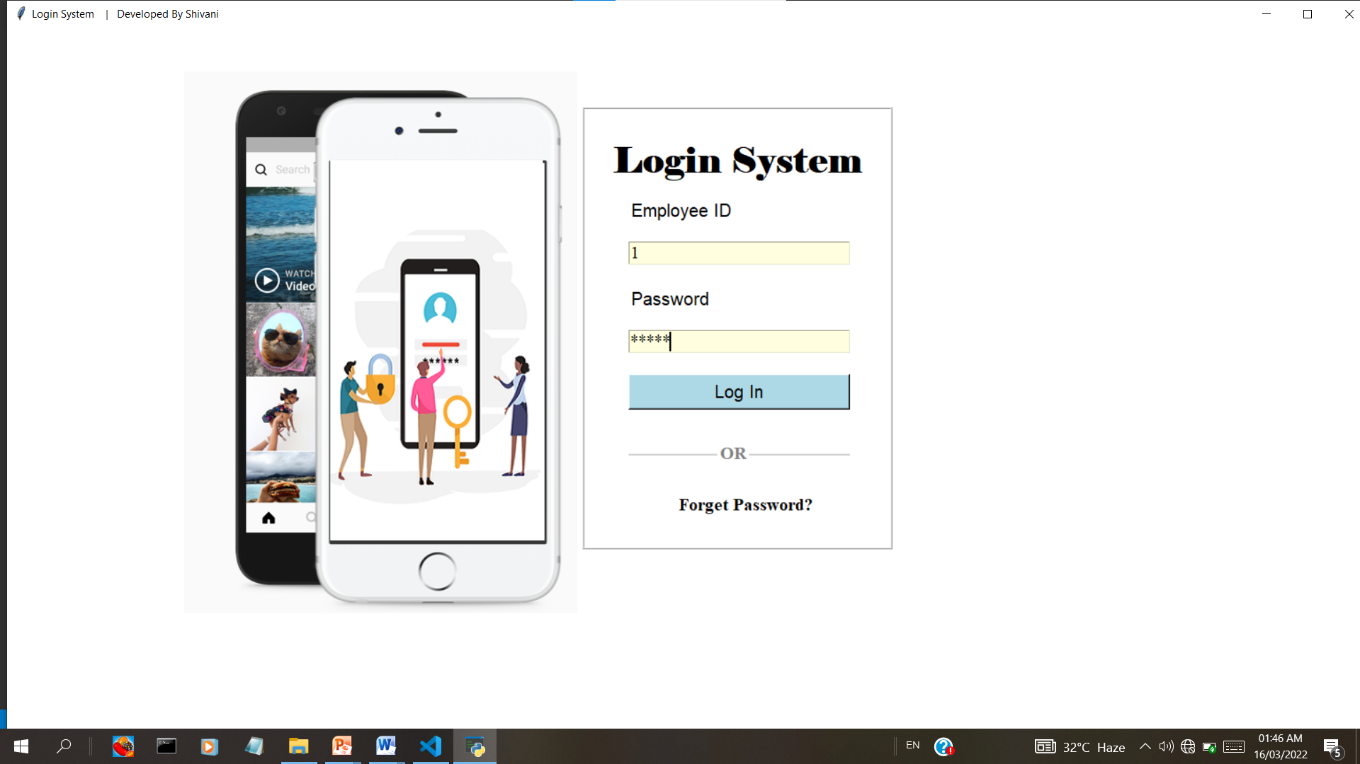
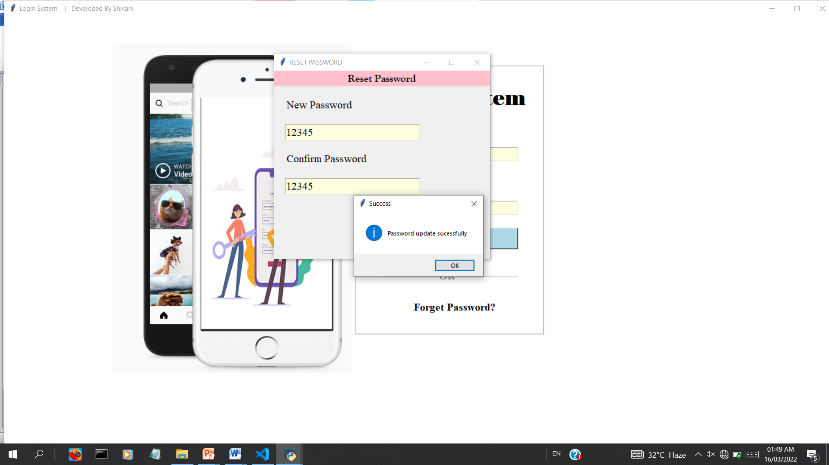
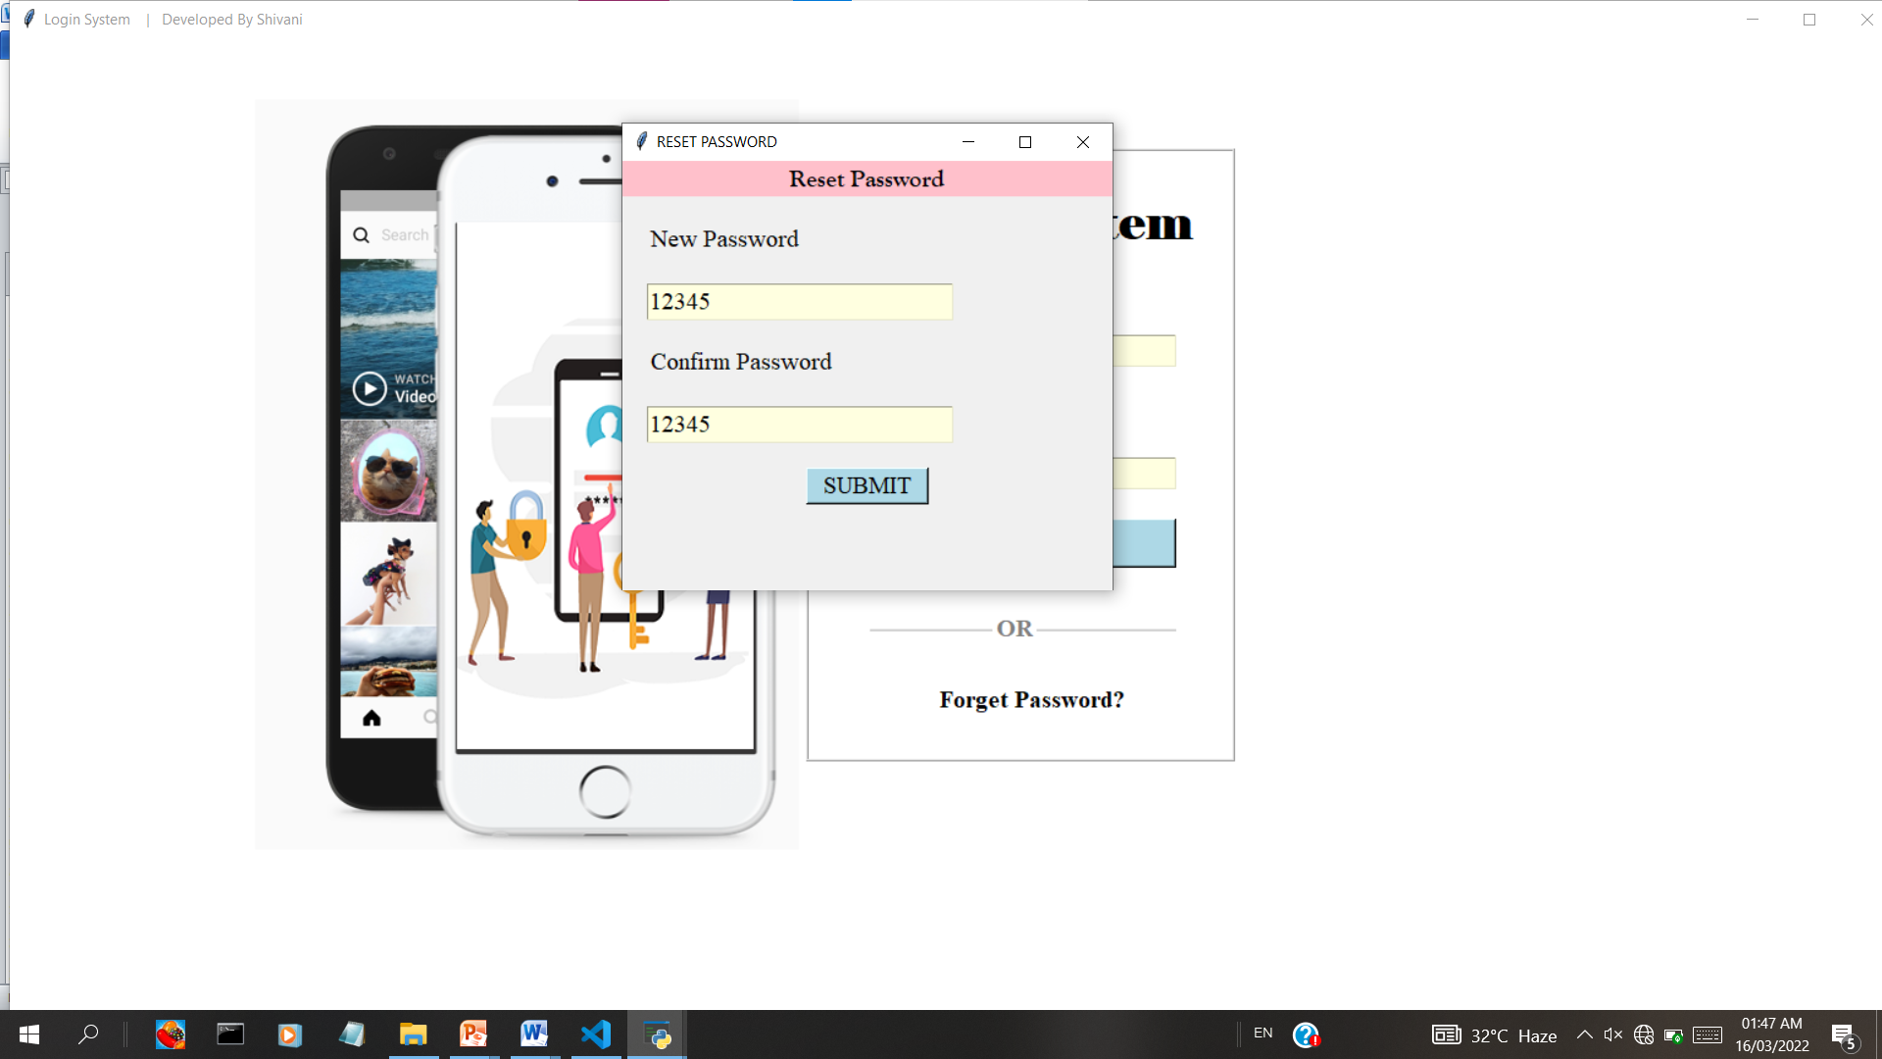
Login page

Slide 19
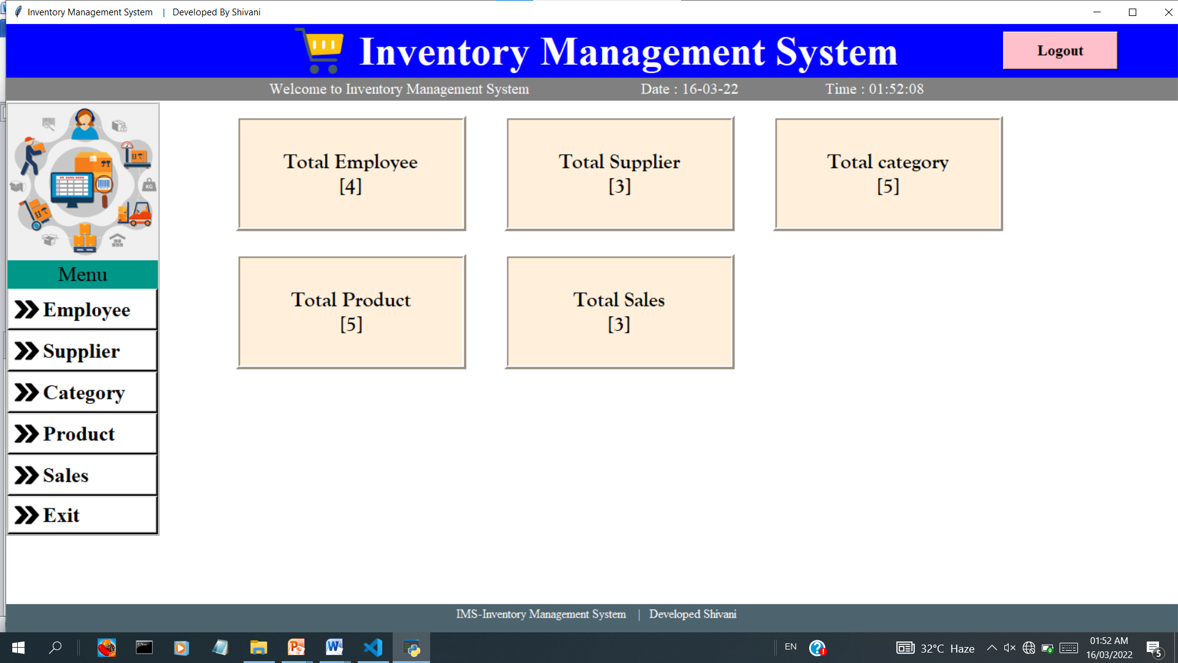
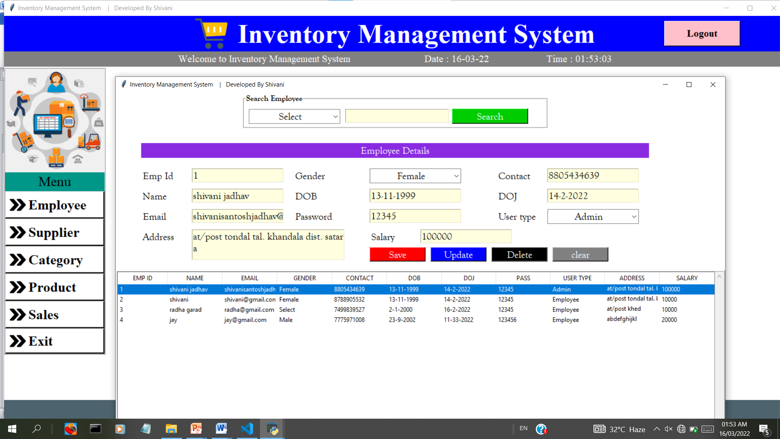
Dashboard
page
Employee
page

Slide 20
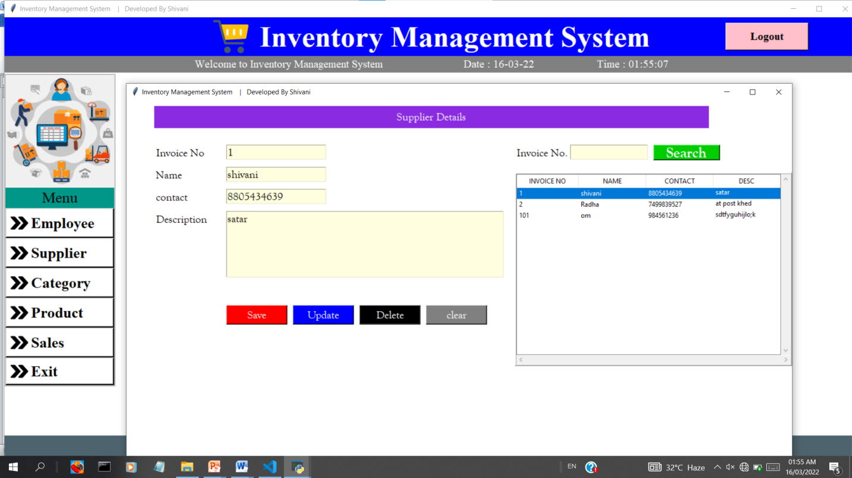
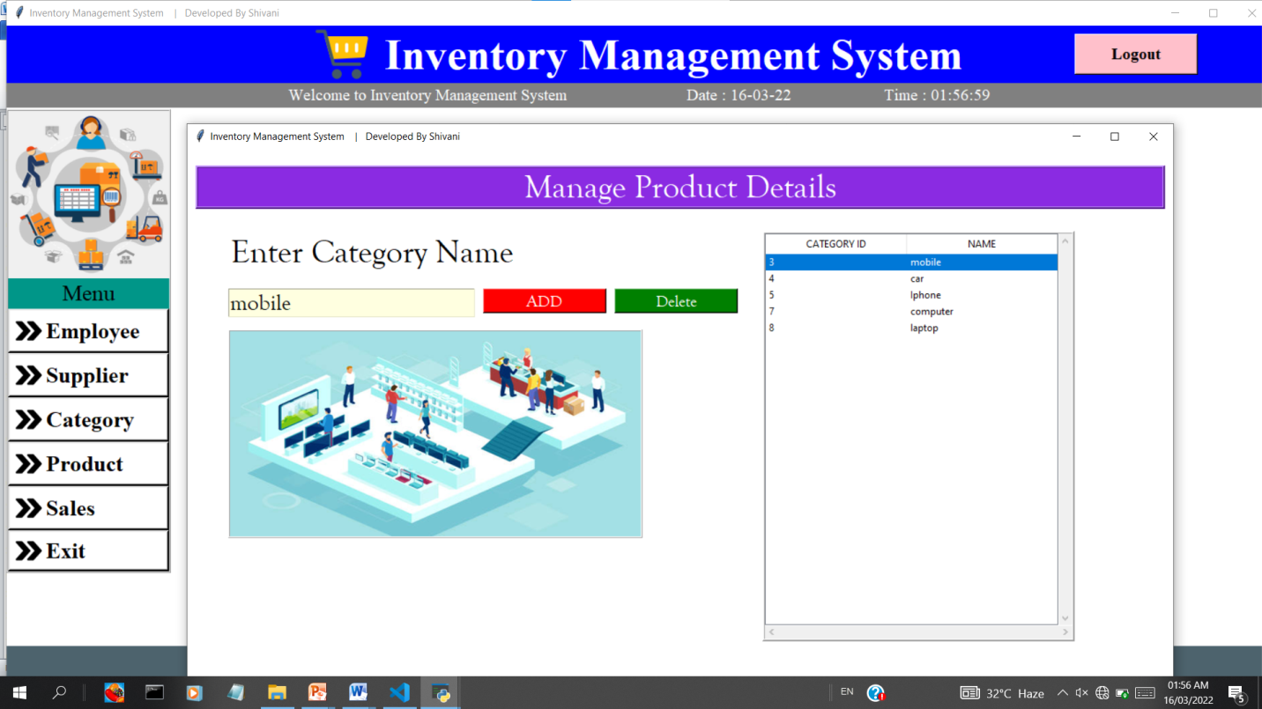
Supplier
page
Category
page

Slide 21
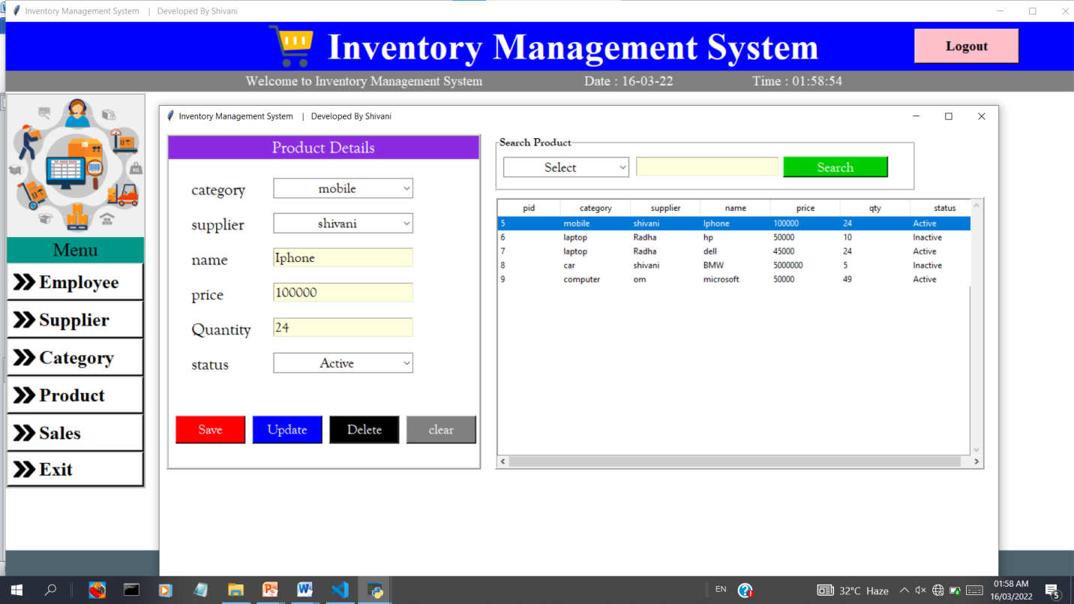
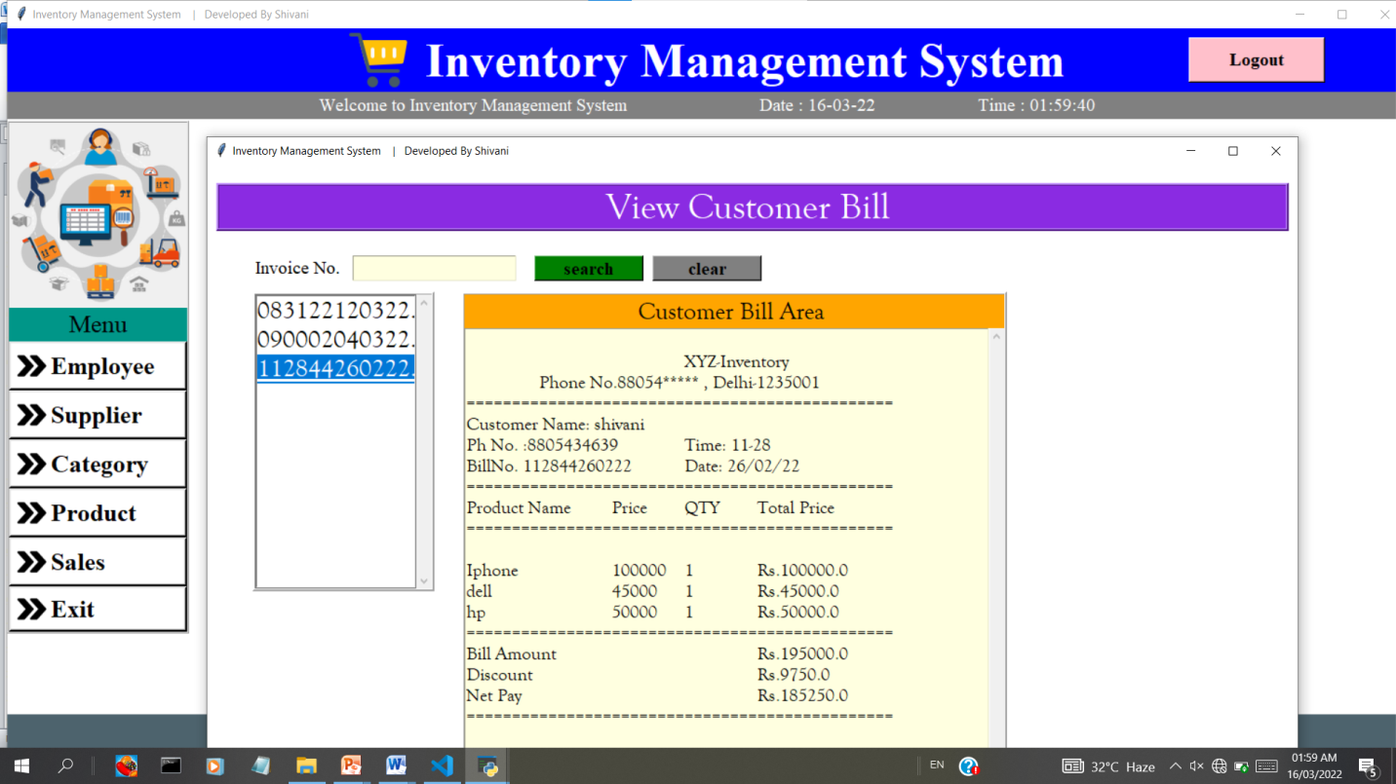
Product
page
Sales
page

Slide 22
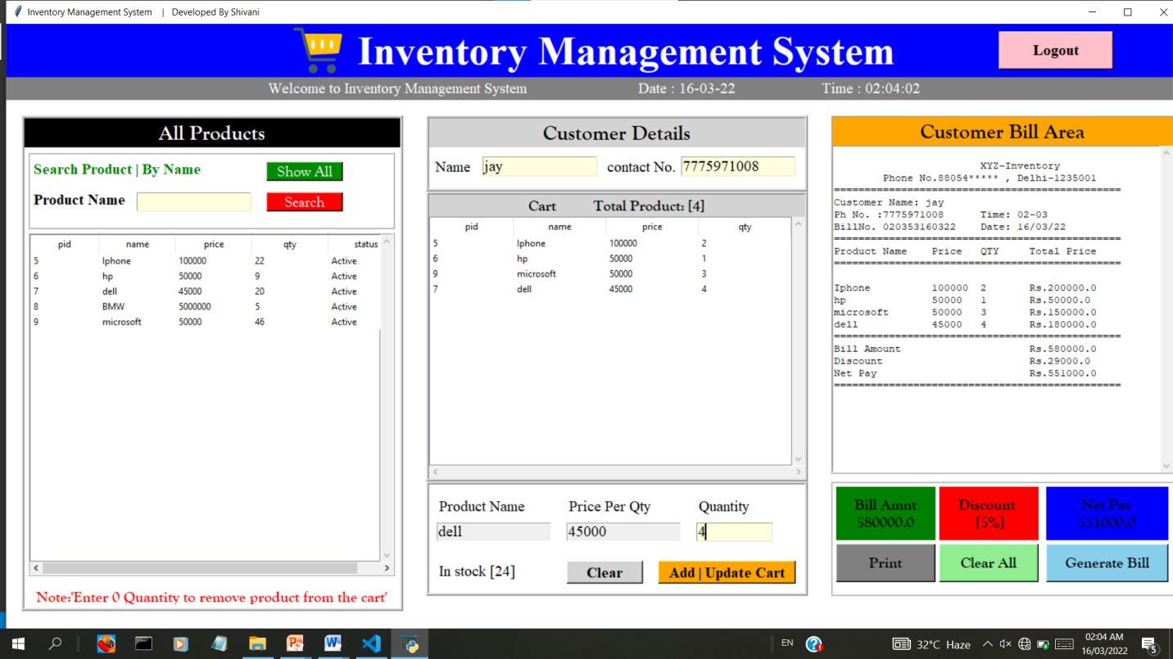
Billing page

Slide 23
CONCLUSION
It was a great experience to design and implement the Inventory management System by using Python and Sql Lite. And to work on its documentation. While working on this project I have learned many things especially how to apply the concept in different models. We learn with the working of different modules of Python and also with different libraries and use of SQL lite.

Slide 24
BIBLIOGRAPHY
www.w3layout.com
www.google.com.
www.chrome.com.
www.w3school.com
You tube
Python by Gourishankar
The complete references
tutorialspoint.com
Programming by Mosh /Edurekha
Coding with web coder

